Slide 1
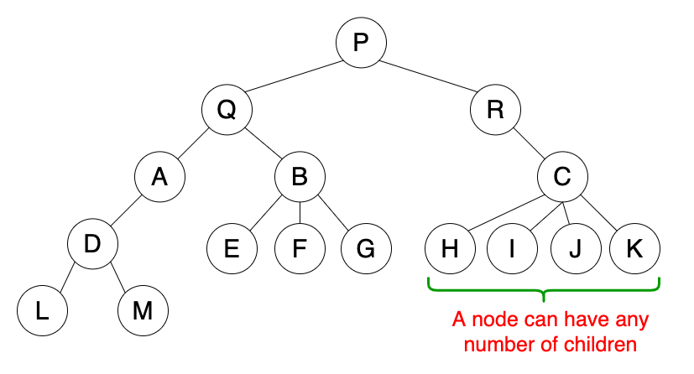
Tree Data Structure
A tree data structure is defined as a collection of nodes that are linked together to represent hierarchy.
A tree data structure is a non-linear data structure because it does not store in a sequential manner. It is a hierarchical structure as elements in a Tree are arranged in multiple levels.

Slide 2
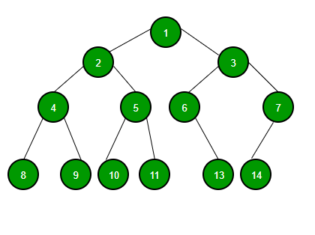
Binary Trees
A tree whose elements have at most 2 children is called a binary tree. Since each element in a binary tree can have only 2 children, we typically name them the left and right child.
A Binary Tree node contains following parts.
Data
Pointer to left child
Pointer to right child

Slide 3
Some basic terms:
Root: The root node is the topmost node in the tree hierarchy.
Child node: If the node is a descendant of any node, then the node is known as a child node.
Parent: If the node contains any sub-node, then that node is said to be the parent of that sub-node.
Sibling: The nodes that have the same parent are known as siblings.
Leaf Node:- The node of the tree, which doesn't have any child node, is called a leaf node.

Slide 4
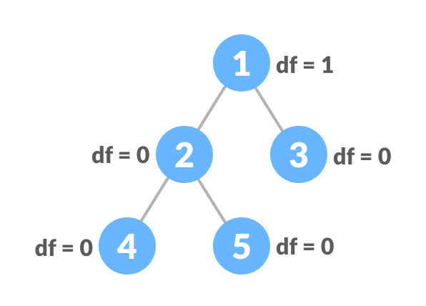
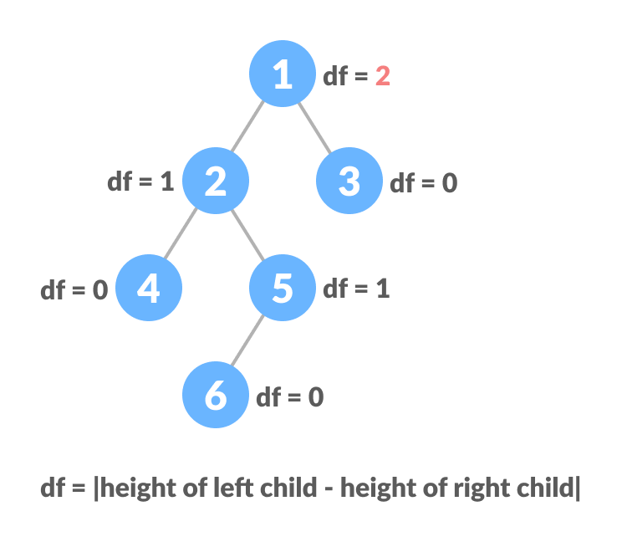
Types of Binary Trees
Full Binary Tree: Each node has exactly zero or two children.
Complete Binary Tree: all levels are completely filled except last level , which is filled from left to right.
Perfect Binary Tree: All leaf nodes are at same level.
Balanced Binary Tree: also referred to as a height-balanced binary tree, is defined as a binary tree in which the height of the left and right subtree of any node differ by not more than 1.

Slide 5
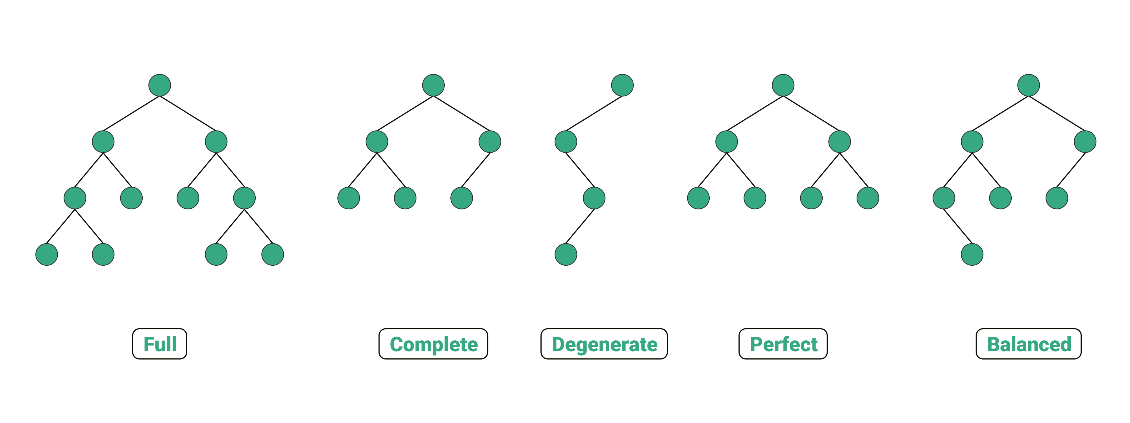
Degenerate Binary Tree: is a Binary Tree where every parent node has only one child node.

Slide 6
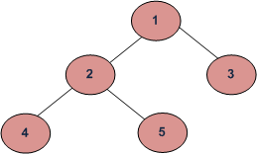
Tree Traversals
Following are the ways used for traversing trees:
Depth First Traversals: (a) Inorder (Left, Root, Right) : 4 2 5 1 3 (b) Preorder (Root, Left, Right) : 1 2 4 5 3 (c) Postorder (Left, Right, Root) : 4 5 2 3 1
Breadth-First or Level Order Traversal: 1 2 3 4 5

Slide 7
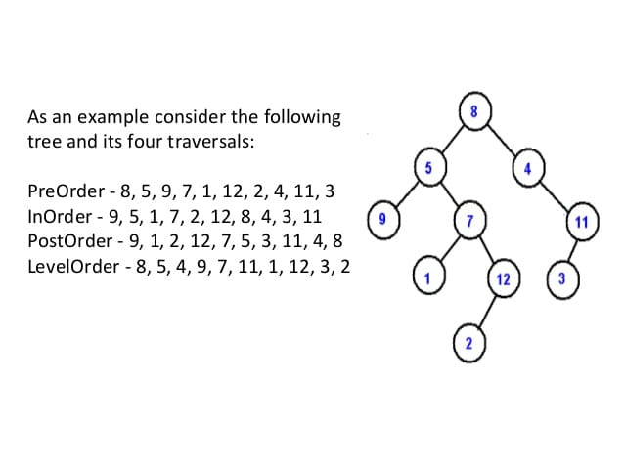

Slide 8
Binary Search Tree
Binary Search Tree is a node-based binary tree data structure which has the following properties:
The left subtree of a node contains only nodes with keys lesser than the node’s key.
The right subtree of a node contains only nodes with keys greater than the node’s key.
The left and right subtree each must also be a binary search tree.

